Slide 1
ONLINE PAYMENT FRAUD DETECTION USING MACHINE LEARNING MODEL
Project By :
Ankit Garg

Slide 2
TABLE OF CONTENTS
INTRODUCTION
EXECUTIVE SUMMARY
VISUALIZATIONS/INTERPRETATION
MODEL EVALUATION
CREATING WEBAPP USING STREAMLIT
CONCLUSION/ RECOMMENDATION

Slide 3
INTRODUCTION
Fraud detection is defined as a process that detects scams and prevents fraudsters from obtaining money or property through false means. Fraudulent transactions pose a significant threat to financial institutions and consumers alike. They result in financial losses, reputational damage, and a decline in customer trust.
To combat this growing challenge, I've developed a sophisticated machine learning model capable of identifying and flagging fraudulent transactions in real-time.
This presentation will delve into the details of our fraud detection model. We'll explore the specific machine learning techniques employed, the data used for training, and the model's effectiveness in recognizing fraudulent activity.

Slide 4
EXECUTIVE SUMMARY
The aim of this project was to develop a model that will predict online payment fraud.
The data was collected, processed, and statistical analysis was done on the dataset. We also did data verification where we checked if we had any missing values and also checked data type.
Exploratory Data Analysis(EDA) was carried out on the dataset for proper visualization and understanding. We explored correlation where it shows the relationships between variables(features) and how close they are related to each other.
Four machine learning algorithms were used to train and test the dataset after which they were evaluated using different metrics for best performance and deployment. We selected our models and target variable. The algorithms used were Logistic Regression, Random Forest, Decision Tree and K-Nearest Neighbors. We trained the dataset on 70% while testing on 30%. Both the Decision Tree and Random Forest models outperform the Logistic Regression and K-Nearest Neighbors model by a wide margin. Since they both have similar recall scores, we performed a cross-validation of the two models so we may declare which is the best performer with more certainty. Out of the 4 Machine Learning Models, Decision Tree performs best with Recall Cross-Validation Accuracy 80.1% which is important for our problem statement where false negative is our priority.
Customers transaction Dataset
Data pre-processing
Model selection and training
Exploratory Data Analysis
Business understanding
Creating WebApp of the Model using Streamlit

Slide 5
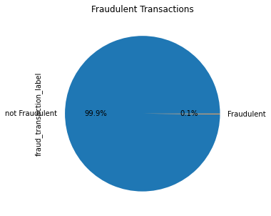
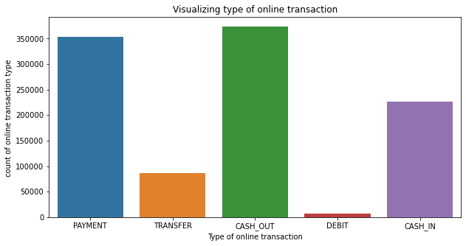
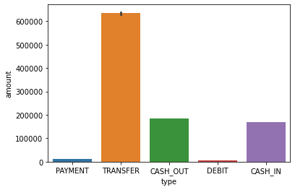
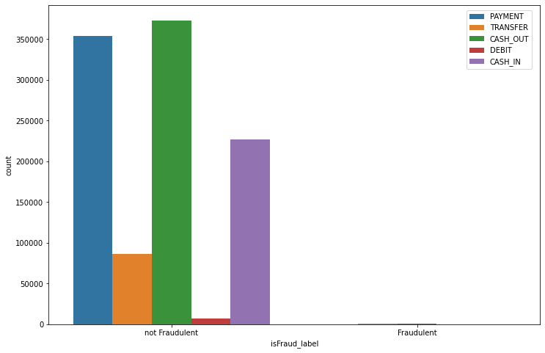
VISUALIZATIONS
From this chart, its shows that most of the online transactions customers does is not fraudulent. Also the dataset is not balance
From the chart, it is seen that cash_out and payment is the most common type of online transaction that customers use.
In this chart, 'transfer' type has the maximum amount of money being transferred from customers to the recipient. Although 'cash out' and 'payment' are the most common type of transactions
Both the above graphs indicate that transactions of the type 'transfer' and 'cash out' comprise fraudulent transactions

Slide 6
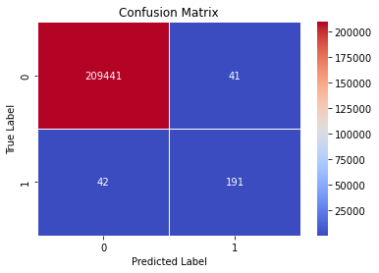

VISUALIZATIONS
The Decision Tree model with default parameters yields 99.96% accuracy on training data.
Precision Score: This means that 82% of all the things we predicted came true. that is 82% of clients transactions was detected to be a fraudulent transaction.
Recall Score: In all the actual positives, we only predicted 82% of it to be true.
Random Forest Tree model with default parameters yields 99.97% accuracy on training data.
Precision Score: This means that 99% of all the things we predicted came true. that is 99% of clients transactions was detected to be a fraudulent transaction.
Recall Score: In all the actual positives, we only predicted 81% of it to be true.
Both the Decision Tree and Random Forest models outperform the Logistic Regression and K-Nearest Neighbors model by a wide margin. Since they both have similar recall scores, we should perform a cross-validation of the two models so we may declare which is the best performer with more certainty.
Conclusion
Upon training and evaluating our classification model, we found that the Decision Tree model performed the better.
Therefore, Random Forest performs best with recall cross-validation accuracy of 80% which is important for our problem statement where false negative is our priority

Slide 7
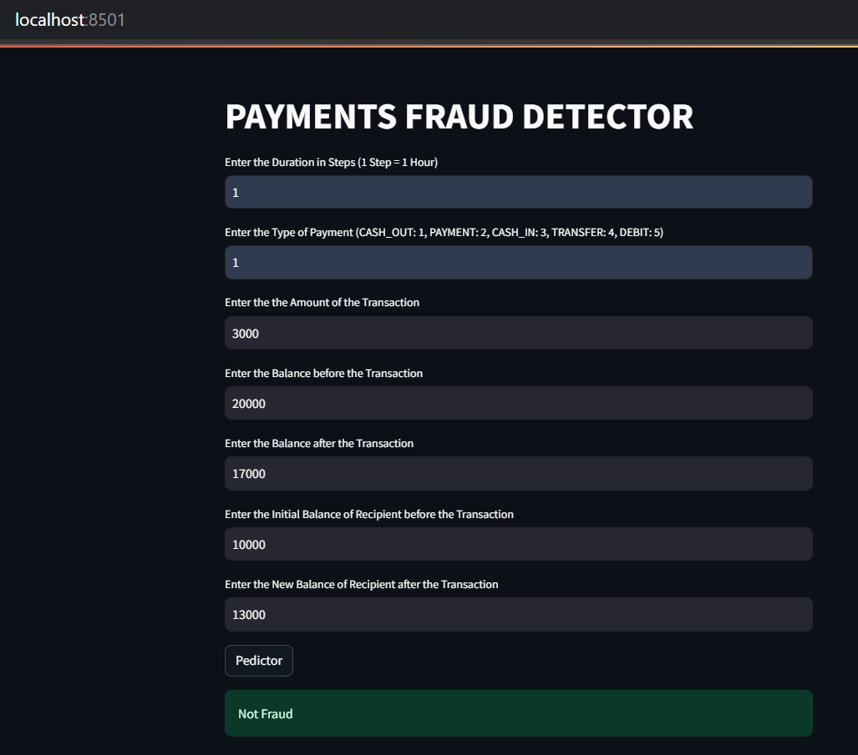
STREAMLIT WEB APPLICATION
Streamlit is an open-source Python framework for creating interactive web applications for data science and machine learning projects, enabling users to build and deploy powerful applications with minimal coding effort.
The Streamlit web application is designed to provide an intuitive and interactive interface for real-time online payment fraud detection.
By leveraging the powerful capabilities of the Streamlit framework, this application ensures that users can easily input transaction details and receive immediate feedback on the likelihood of fraud.
The app serves as a seamless bridge between complex machine learning models and end-users, making sophisticated fraud detection accessible to non-technical stakeholders.

Slide 8
CONCLUSION
Decision Tree Classifier model should be deployed because for this business problem, recall score is more relevant because it measures how many of the actual fraudulent payments the model identified as fraud.
In conclusion, our machine learning model has emerged as a powerful weapon in the ongoing war against fraud. Its ability to continuously learn and adapt provides a significant advantage over static, rule-based systems. As fraudsters develop new tactics, the model can be retrained to identify these emerging threats. By leveraging these advancements, we can create a more secure and reliable financial ecosystem for everyone.

Slide 9

Thank You

